Slide 1
Dear boys and girls! We are going to travel in the galaxy of English tenses today.

Slide 2
We know different English tenses:
Present Indefinite
Past Indefinite
Future Indefinite
Present Progressive
What’s my name?

Slide 3
Формы Present Indefinite употребляются для констатации факта, для выражения повторяющегося действия или действия, свойственного данному лицу или предмету.
My name is Dima.
My family is big.
Belgorod is a city in central Russia.
Winter is my favourite season.
I go to school every day.
My Dad likes reading.
Do you play computer games?

Slide 4
.
Past Indefinite служит для выражения действия, которое совершалось в прошлом, в повествовании или в разговоре о прошедших событиях.
I was there 3 days ago.
My Dad travelled a lot last year.
Yesterday I wrote a letter.
He did not read.
Where did you go last summer?

Slide 5
.
Формы Future Indefinite употребляются для выражения действий, которые совершатся в будущем.
I’ ll go to school tomorrow.
He won’t get up till 9.
Will you travel abroad next summer?

Slide 6
.
Формы Present Continuous употребляется для выражения длительного действия, совершающегося в момент речи.
I am reading now.
What are you doing here?
My friend is not standing at the door.

Slide 7
1. Where ... your parents last week?
A are С were
В did D was
2. Nick ... to school every day.
A goes С go
В went D will go
3. Jane ... not ... bread and milk tomorrow.
A did ... buy С does ... buy
В will ... buy D do ... buy
4. I usually ... my mother in the evening.
A helped С help
В helps D will help
5. My friend ... at school last week.
A weren't С isn't
В didn't be D wasn't
6. They ... to the Zoo next week.
A goes В go
С will go D went
7. There ... a bookshelf in my room.
A are С were
B is D shall be
?
?
Choose
the right
variant:
?
?
?

Slide 8
1. Where were your parents last week?
2. Nick goes to school every day.
3. Jane will not buy bread and milk tomorrow.
4. I usually help my mother in the evening.
5. My friend wasn't at school last week.
6. They will go to the Zoo next week.
7. There is a bookshelf in my room.
well done!

Slide 9
Present Perfect
употребляется для выражения действия, происходившего до настоящего момента или прекратившегося к настоящему моменту;
время, когда именно происходило действие, не упоминается;
важно только, что это действие связано с настоящей ситуацией, которое является как бы продолжением этого действия, его результатом.
Past
результат
Present

Slide 10
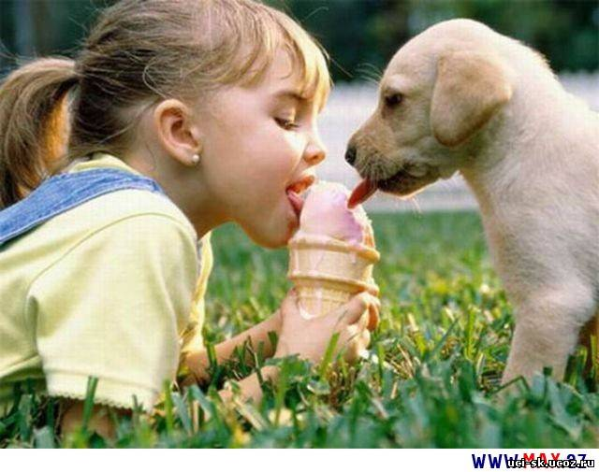
My parents have bought me a puppy!
I like it very much.

Slide 11
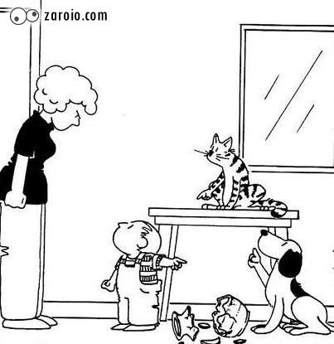
Who has broken a vase?

Slide 12
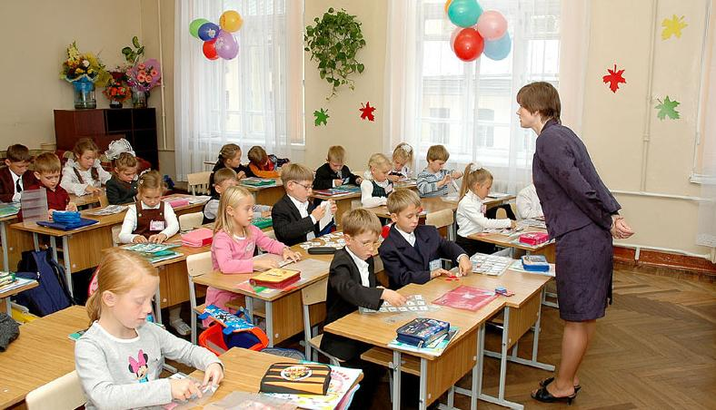
The lesson has begun.

Slide 13
Present Perfect образуется при помощи вспомогательного глагола have в настоящем времени и третьей формы смыслового глагола.
I
We
You
They
V + ed Regular
V₃ Irregular
have
+
yet(еще нет)
She
He
It
V + ed Regular
V₃ Irregular
has
+
Предложения часто содержат слова already (уже), just(только что), never(никогда), ever(когда-либо), yet(еще нет) и др.

Slide 14
Make up sentences:
I
We
They
She
Mike
have
has
already
just
washed
cleaned
finished
found
drunk
my
his
your
our
their
her
hair.
book.
work.
juice.
room.

Slide 15
Complete the sentences.
Trafalgar, I, never. to, been, Square, have.
Letter, has, Mike, already, that, read.
Has, he, not, aunt, visited, his.
Invited, we, just, have, friends, our.
Have, work, finished, children, already, their.

Slide 16
Correct mistakes.
I have already clean my parrot’s cage.
I have watched just this film.
I have already clean my parrot’s cage.
I have not see Ann today.
He all over the world has travelled.

Slide 17
Translate into English.
Я уже пригласила гостей на свой день рождения.
Моя сестра вычистила клетку своего попугая.
Она уже выпила свой сок.
Я сделал уроки. Теперь я собираюсь гулять.
Мой друг принес интересную книгу.

Slide 18
That was very good!
We have done enough today.
See you next time.
Когда англичане используют Present Perfect?
Как образуется эта форма?
Какие слова становятся часто спутниками этих предложений?

